Slide 1
School Choice
We bring it to you!

Slide 2

Is your child reaching their full potential in the the public school system?

Slide 3
Is your public school teaching the fundamental and core basic subjects to proficiency?

Slide 4
If not….do you know why?

Slide 5

Why Public Education
is Failing in America;
Entanglement with
Teachers’ Unions
Credit:
Prager U
20:00

Slide 6
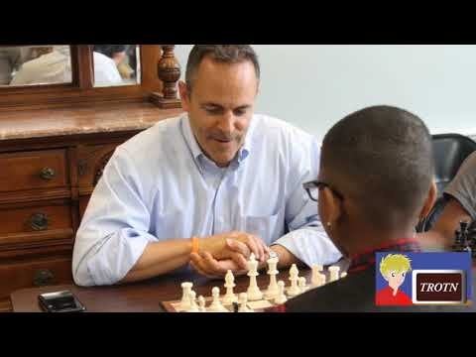
Bluegrass Institute &
JCPS performance data.
Credit:
The Rest of the News

Slide 7
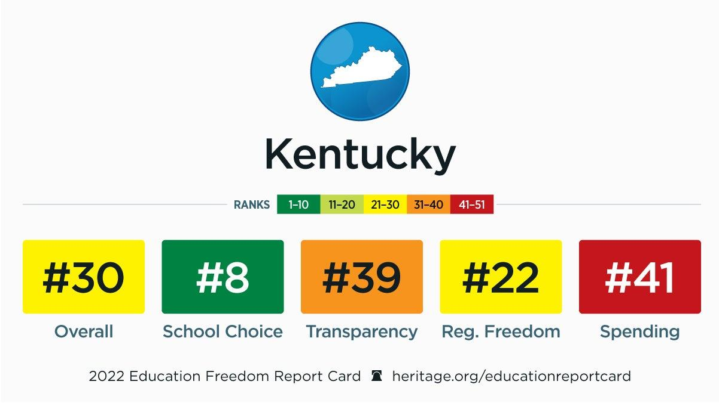
Portfolio samples

Slide 8
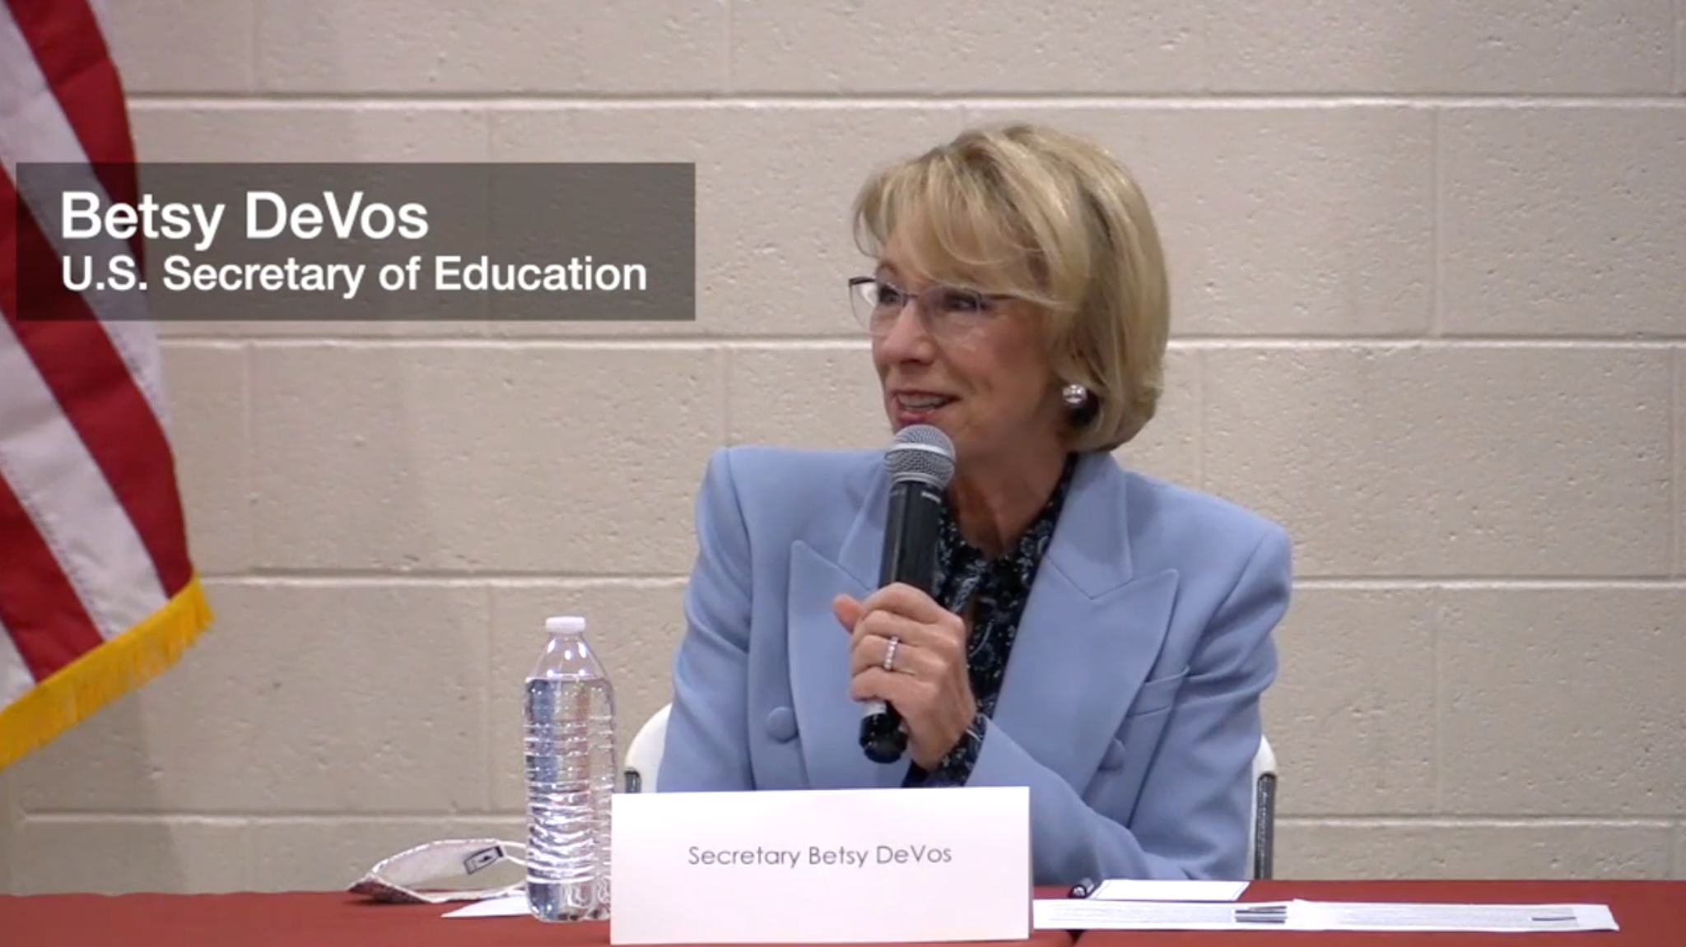
Kentucky Pastors
In Action /
Bluegrass
Institute
Short Video in article link
Credit:
The Bluegrass Institute
https://bipps.org/blog/bluegrass-institute-and-ky-pastors-in-action-coalition-host-us-secretary-of-education-betsy-devos

Slide 9

Why Do We Care? We are Kentucky Family Association
Credit:
The Rest of the News
:30
Video link

Slide 10
We Think
There is A Better Way!
A.C.E. School of Tomorrow

Slide 11

What is
A.C.E. ?
Credit:
A.C.E. School of Tomorrow
1:14 min

Slide 12

Why Choose
A.C.E. ?
Credit:
A.C.E. School of Tomorrow
1:50 min

Slide 13

Presenting
A.C.E. ?
Credit:
A.C.E. School of Tomorrow
26:29 min

Slide 14
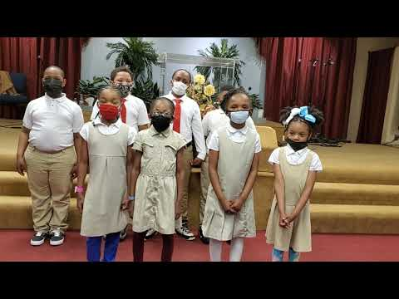
Derek Wilson,
Destiny Academy
A.C.E. testimony
Credit:
Destiny Academy
placeholder

Slide 15
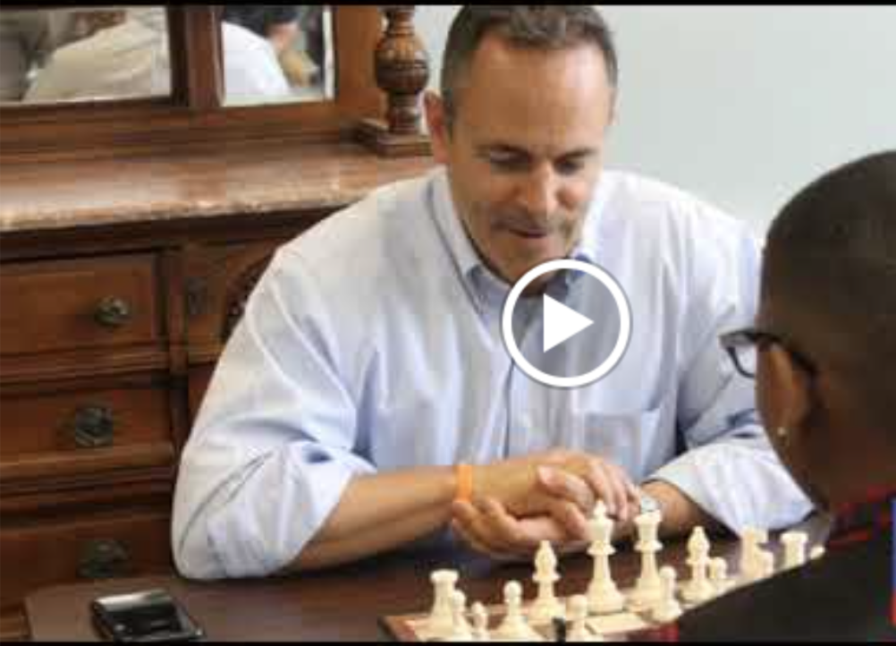
Governor
Matt Bevin,
Is Educated, in part, by A.C.E.
Credit:
Matt Bevin
placeholder

Slide 16
What Next?
Register
Schedule
to Visit
Participating School.
Get Tested
Connect

Slide 17

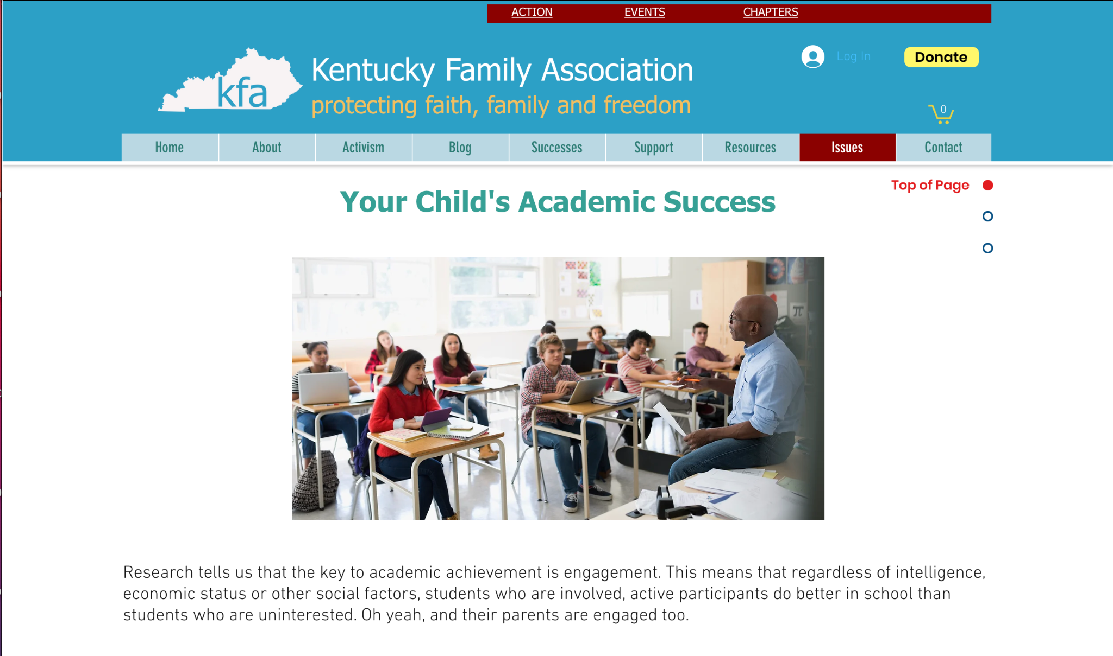




How to Get Started.
Speak with representative before you leave today to sign up to be contacted about next steps.
Let us know special circumstance, needs or accommodations that you need met.

Slide 18
Contact Us
Phone Number
502-893-2444
Mailing Address:
P.O. Box 8089
Louisville, KY 40257-8089
Email:
Info@afaky.org

Slide 19
Your Children’s
Future Depends On It!
WE THANK YOU
FOR COMING!

